Slide 1
Exploratory analyses of a Gene-Disease Network
By Anthony Fernando
SNA Seminar
Supervisor: Dr. Annika Baumann

Slide 2
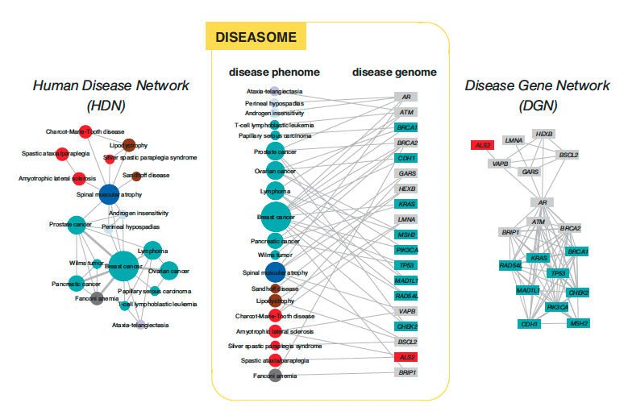
Introduction/Motivation
Hard to identify which causes are responsible for a disease
-> Solution Genes- Disease Network analyses
Similar research in 2007
Goh, Cusick, Valle, Childs, Vidal & Barabási, PNAS (2007)
Problem: There are too many different genes that are associated with just one disease
Notes:
Wir schreiben das Jahr 2022 und es gibt viele Arten von Krankheiten auf der und viele davon sidn gefährlich. Es gibt viele Gründe warum eine Krankheit in erscheinung tritt. Im jungen Zeitalter der Wissenschaft wurde herrausgefunden das Gene mit Krankheiten assoziert sind. Es gibt verschiede Arten wie man soeien assoziation zwischen Genen und KRankehiten analysieren kann. Eine bekannte ist die analyse eines Gene Diesase Network , was hier eine bipartied graph ist Im Jahre 2007 wurde sowas ähnliches Gemacht , und als resultat erhält man 2 Projection wo man die interaktionen von Krankehiten und Genen herrasgefunden hat und daraus schlussfolgern konnte welche Krankheit mit welcher andern Krankheit bzw welches Gen mit welchen Genen verbunden ist.
Folie 1
Welcome to my final Seminar presentation about the topic An Exploratory analyses of a Gene-Disease
Folie 2
Let me first give you a short introduction and motivation of my topic
It is the year 2022 and there are many types of diseases
->and many of them are dangerous.
There are many reasons why a disease appears.
In the early years Scitiest discovered that genes are associated with diseases.
and There are different ways to analyze the association between genes and diseases. A well-known one is the analysis of a Gene Diesase Network,
->which is here an analysis bipartite graph.
In 2007 something similar have been done
and as a result they created 2 projections where you can find the interactions of diseases and genes
and conclude which disease is associated with which other disease or which gene is associated with which genes.

Slide 3
Seminar AIM and Research Questions
Aim: Create Gene-Disease Network and their corresponding projection
1. What is the combination of genes that produces the most number of diseases?
2. What is the combination of diseases to make a prediction of how high the risk is of having disease A when you have disease B?
Projection Analyses to answer RQ:
RQ1: Are genes more likely connected when they are similar to each other (exact location or number of proteins produced)?
RQ2 : Are diseases more likely to be associated with each other if they have the same property (a disease in the same organ or the same illness)?
Notes:
Nichtdetotzotz gibt es manchmal soviele Gene die mit einer Krankheit assoziert sind das es schwierig ist das eine richtige Gene zu finden.
In meinen Seminar project möchte ich sowas ähnliches replizieren. Ich habe ein Gene diase Datensatz genommen und es so gefiltert das ich am Ende nur die Gene hab die Krankheiten miteinenader verbindet die mit den meisten Genen assoziert sind , das heißt Krankheiten mit einen hohen degree. Dabei ist mein 1.Find out a combinations of genes that produce most diseases
2. Find a combination of diseases to make a prediction of how high the risk is of having disease A when you have disease b.
Gleichzeitig möchte ich 2 Fragen basierend auf der Projection beantworten.
Basierend auf den Krankheitsprojection
Verbinden sich Krankheiten die gleiche Eigenschaft haben sei es Krankheit im Organ oder selbe Krankheit eher oder ist es eher unterschiedlich
Basierend auf Gene
Verbinden sich Gene miteinenader eher die ähnlcih zueinenader sind eher (sei est selbe Location oder anzahl der Produzierten Proteine)

Slide 4
Background information

Slide 5

Example: drinking milk

Slide 6
Lactose
Lactase(Enzyme)
Body

Slide 7

What if the Lactase Gene is not available:

Slide 8
Methods

Slide 9
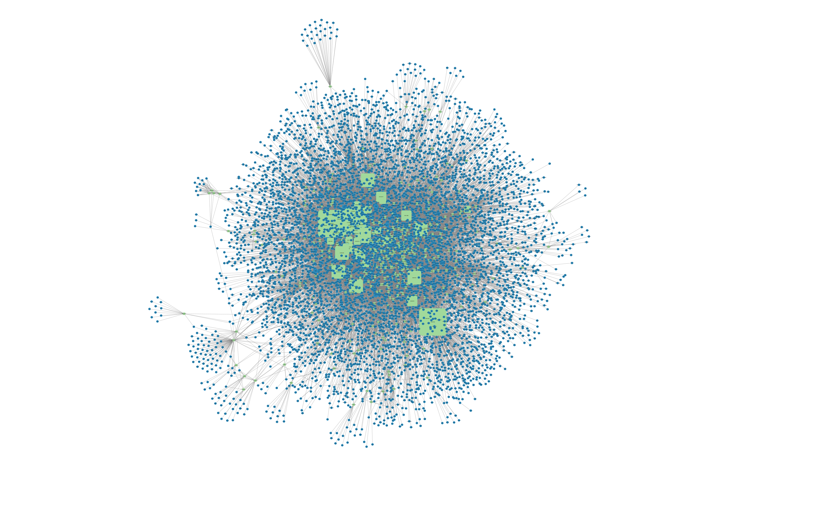
Data set
Stanford Large Network Dataset Collection
Nodes: 7813
Disease nodes: 519
Gene nodes: 7294
Edges: 21357
Green=Disease
Blue=Gene
Notes:
Green= Disease
Blue=Gene

Slide 10
Data Pre-processing
1. Find all genes that occur only 2-6 in the data set
-> select all diseases that are associated with these genes
2. For each disease associated with a gene in the filtered dataset
-> list the diseases that are associated with the most numbers of genes from the original data
3. Filter these diseases again
-> consider only those that are associated with more than 100 genes
4. Filter all diseases and look for the diseases that are connected with 5 or 6 genes

Slide 11
Results

Slide 12
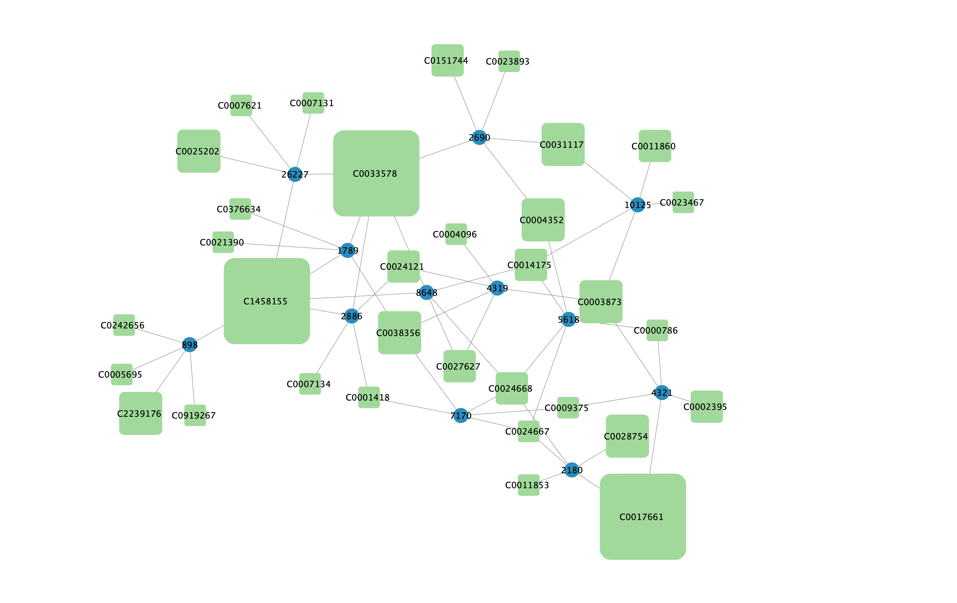
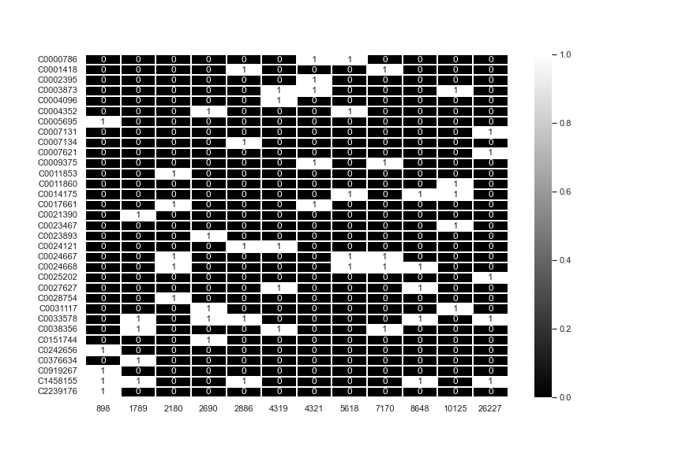
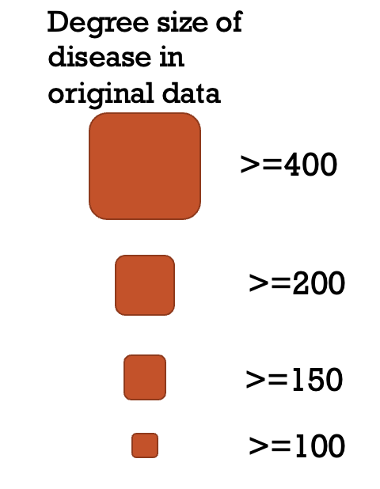
Gene - Disease Network after filtering
Number of nodes:45
Number of edges: 60
Disease node:33
Gene node:12
Heatmap

Slide 13
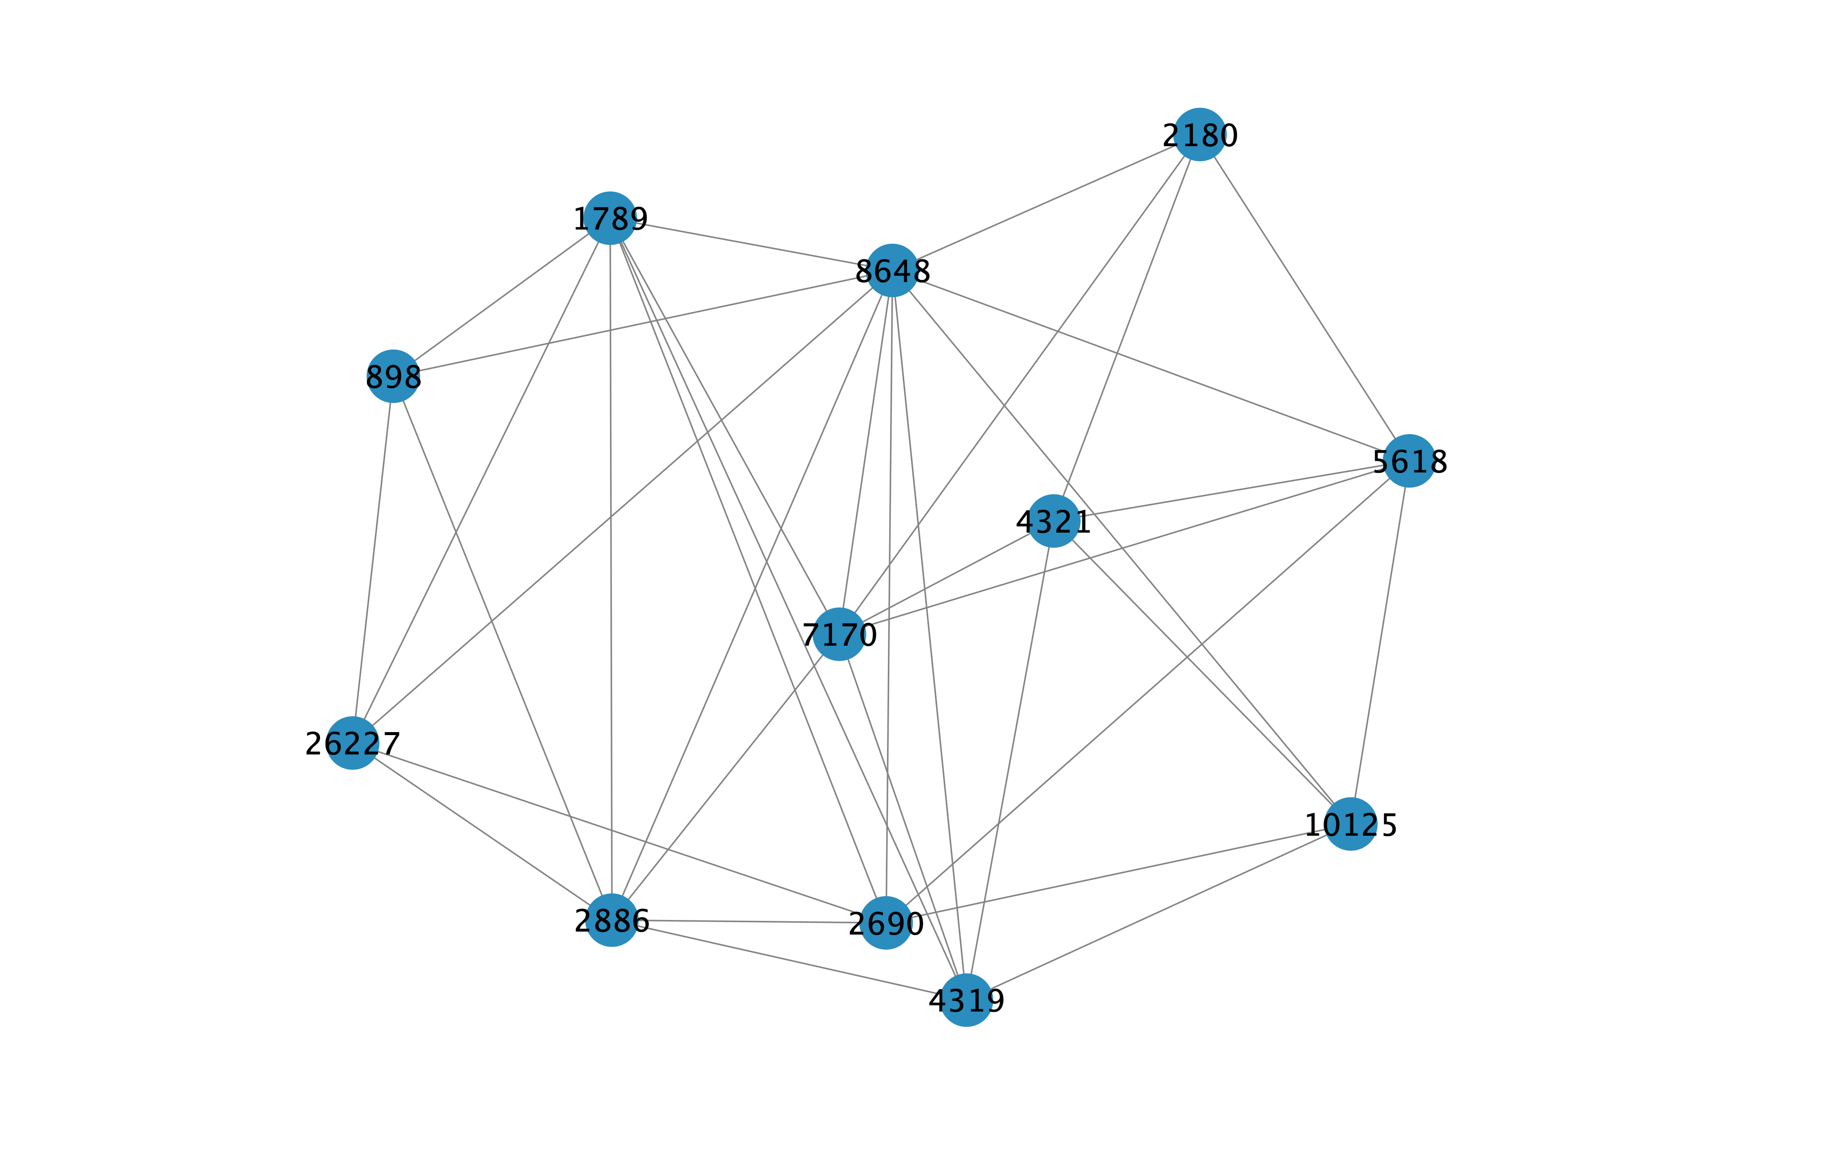
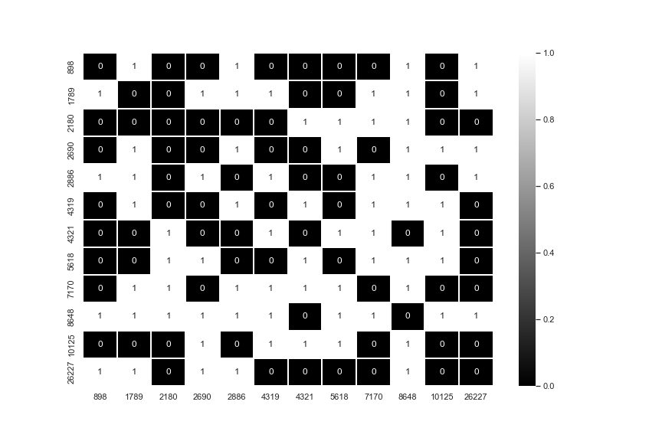
Gene NEtwork
Number of nodes=12
Number of edges= 36
Notes:
12 Gene
Gene “8648 “ connected with 10 from 12 GenesGro
-> not connected to 4321
-> Gene 5618 als Vollständige Schnittmenge
-> Gene das am wenigsten verbunden ist mit den andeen Genen
-> 898 und 2180
-> Aufgabe von beiden Genen
-> meisten Genen zuständig für Biologische Prozesse

Slide 14
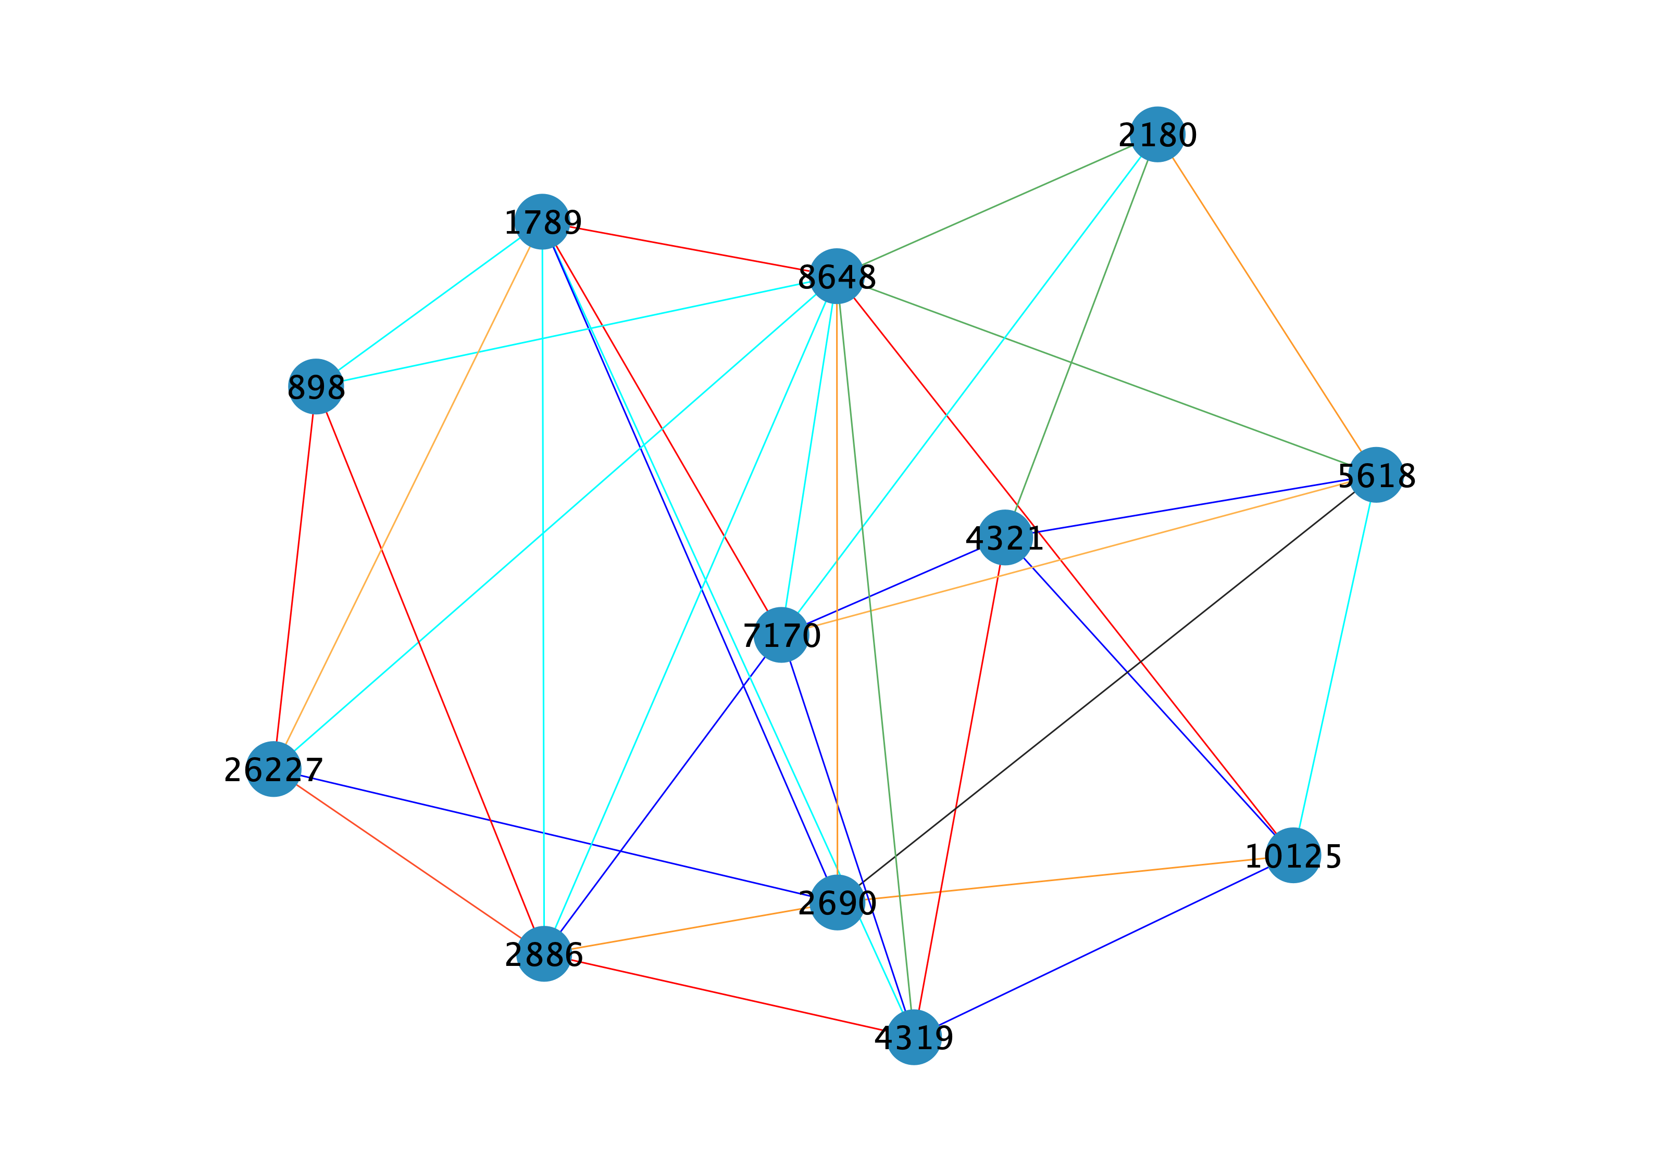
Weighted Gene Network
Legend
Cyan= Similar nr of cellular component function
Green=Similar nr of biological process function
Red= Expression in similar organ
Orange=Generate similar nr of proteins
Black= Located in same chromosome
Blue=Similar nr of molecular function
Notes:
-Gene are connected are in different weight by colour
same organ (dick) rot
- similar organ rot
- gleiche anzahl an aufgaben cellular pink/cyan
- anzahl Biologisch prozesse grün
- generates similar nr of protein orange
- (similar nr of molecular function blau
- located same chromosome schwarz
-> each can represent
-> - bsp. sieht man zwei Gruppen:
-> 7170-1789-8648-10125
-> 4321-4319-2886-26227-898
-> diese beiden sidn zsm verbunden durch similar nr of molecular function

Slide 15
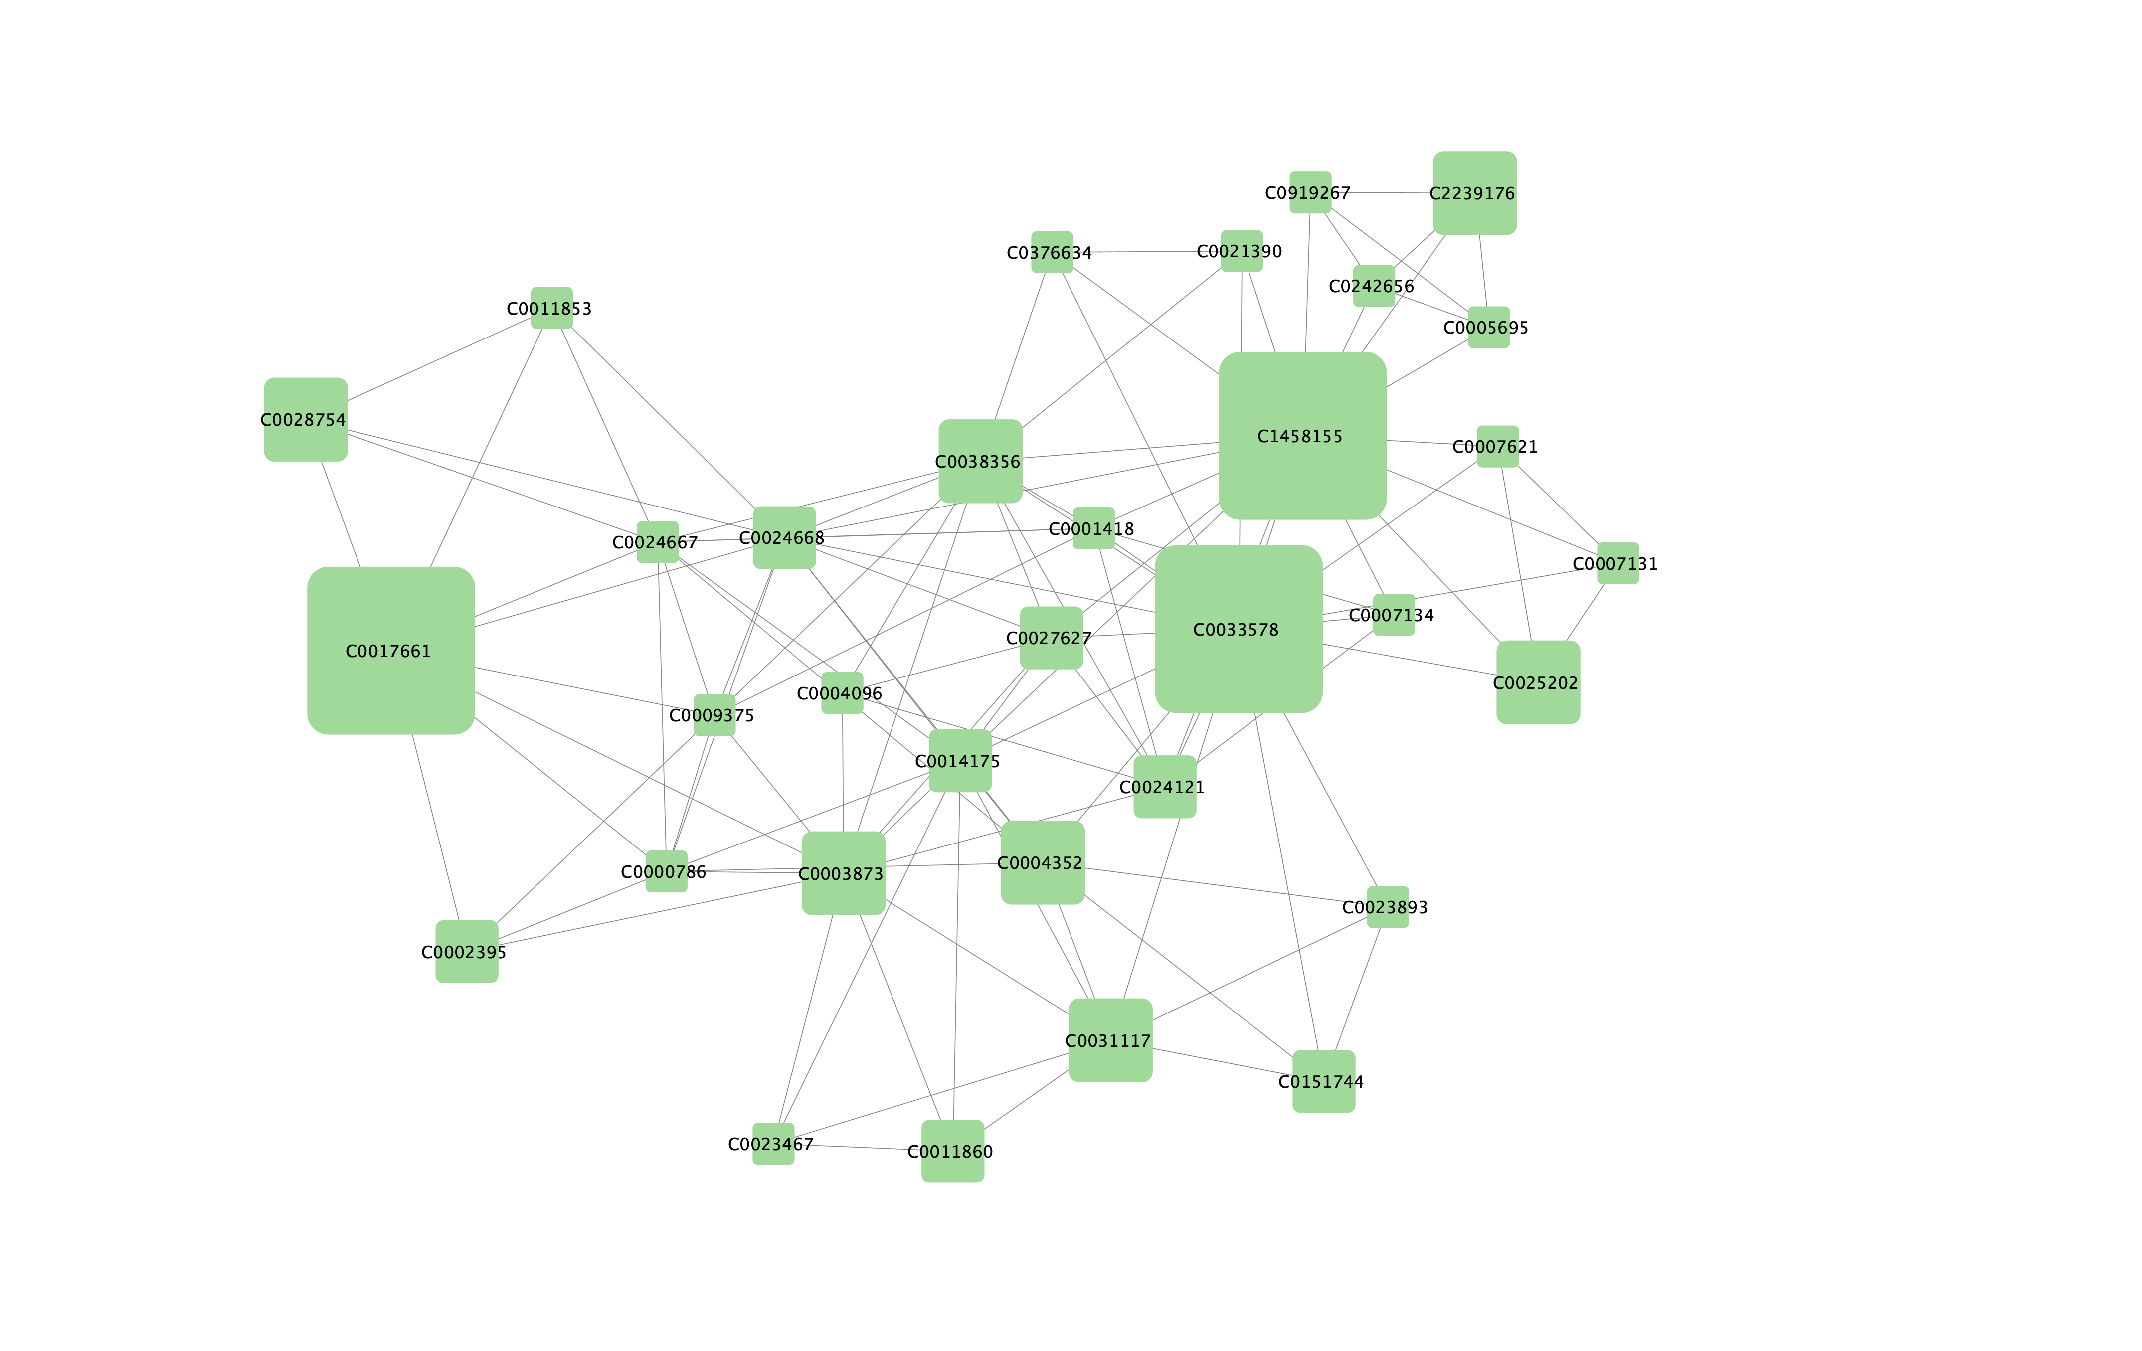
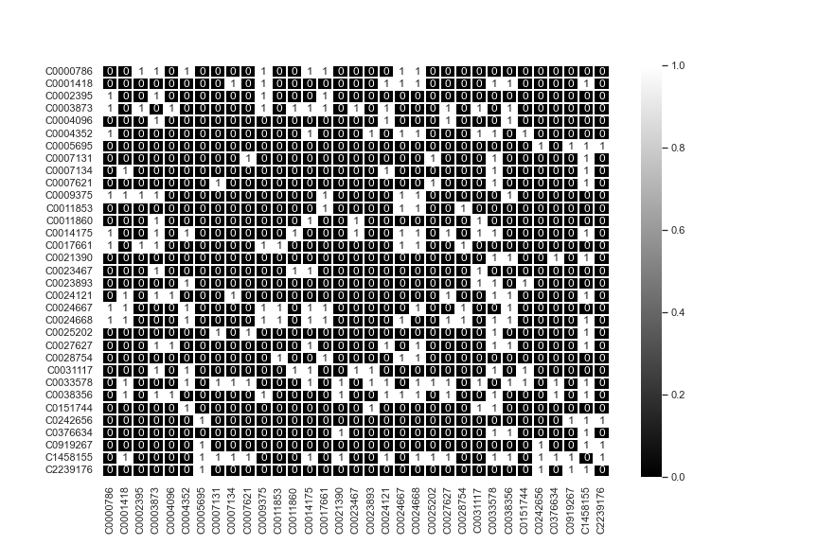
Disease Network
Number of nodes= 33
Number of edges= 114
Notes:
33 Diseases
Beiden C1458155 UND C0033578
->C0038356,C0024668,C0003873
Number of nodes=33
Number of edges=114
- Welches Diseases das sind
- Closnes centrality
-> wenn man close berechnet knote

Slide 16
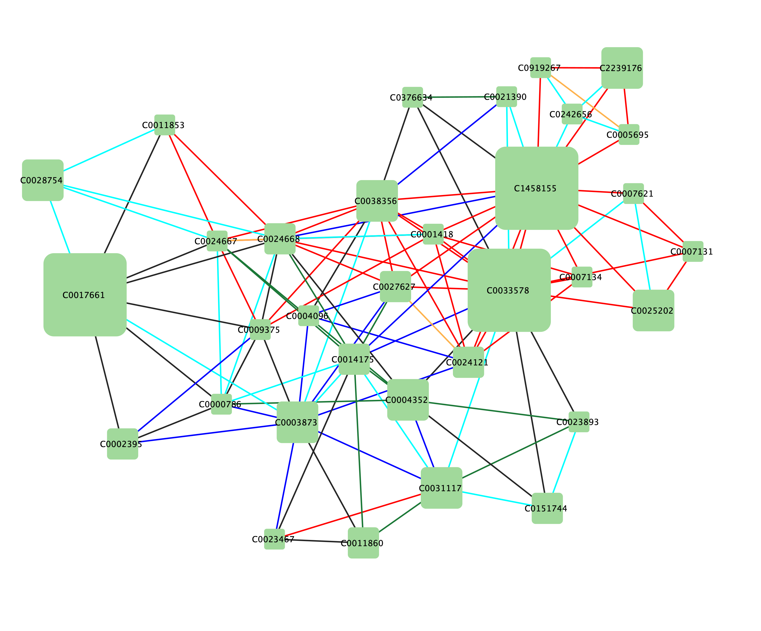
Weighted Disease Network
Legend
Same organ (Blue)
Same disease (Red)
Same organ and same disease (Orange)
Disease result from other diseases (Cyan)
Similar nr of genes (Green)
None (Black)
Notes:
Same organ (blau)
Same Disease (Rote)
Same organ and same disease (Orange)
Disease result from other diseases. (cyan)
Similar nr of genes (grün)
None (schwarz)
- C0007131
-> Diseases hat die gleiche Disases Cancer
- C0017661
-> Dieses haben keine gemeinsamkeiten wie
C0003873
-> gleiche Organ
Disease namen nenen

Slide 17
General Questions - Gene Network
1. What is the combination of genes that produce the most number of diseases?
-> 8648 and 5618

Slide 18
General Questions - Disease Network
2. What is the combination of diseases to make a prediction of how high the risk is of having disease A when you have disease B?
Closeness centrality
The closeness centrality of a node measures its average farness (inverse distance) to all other nodes. Nodes with a high closeness score have the shortest distances to all other nodes.

Slide 19
RQ1 - Gene specific:
RQ1: Are genes more likely connected when they are similar to each other (exact location or number of proteins produced)?
-> Yes if we take a look at the path ,we can see mostly the same colour or attribute

Slide 20
RQ2 - Disease specific:
RQ2: Are diseases more likely to be associated with each other if they have the same property (a disease in the same organ or the same illness)?
Notes:
Yes if we take a look at the path we we can see mostly the same colour or attribut

Slide 21
THE End

Slide 22
Source
https://www.shutterstock.com/de/image-vector/cartoon-style-illustration-cute-cow-passing-1611976603
https://medlineplus.gov/genetics/understanding/basics/gene/
Goh, Kwang-Il, et al. "The human disease network." Proceedings of the National Academy of Sciences 104.21 (2007): 8685-8690
https://www.shutterstock.com/de/image-vector/functions-proteins-anatomical-roles-body-outline-2023269851
https://neo4j.com/docs/graph-data-science/current/algorithms/closeness-centrality/

